Slide 1
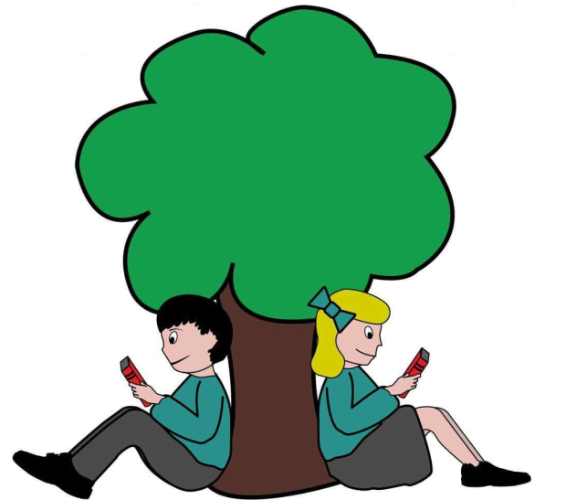
Beech Hill Community Primary School
Specialist Resource Base
Parents Information Pack

Slide 2


Beech Hill Community Primary School
Information Pack
Dear Parents,
We are looking forward to welcoming you and your child in to the Kites class at Beech Hill Community Primary School in September.
We want this to be the beginning of a happy and successful time for your child and a supportive partnership with you. We understand that this transition could be a bit of a nervous time for both children and parents. The aim of this booklet is to provide you with practical information and some useful advice to help make your child’s transition into Kites Class as smooth as possible. This is a journey we will make together, we look forward to it.
You will find various top tips which are things other parents have found helpful to know and wanted to share. Top tips are easy to spot and look like this:
If you have any questions or concerns, please do not hesitate to contact me.
Kind Regards
Miss Lyndsey Marie Yates SEND Teacher

Slide 3
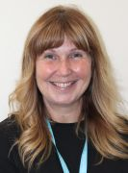
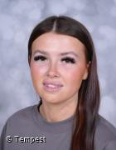
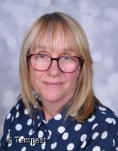
Meet the staff
Miss Lyndsey Marie Yates SEND Teacher
Miss Romanie Morgan
Teaching Assistant
Mrs. Rebecca Macdonough
Teaching Assistant

Slide 4
Welcome To Kite Class
Beech Hill Community Primary’s Specialist Resource Base is designed to meet the needs of children who have a diagnosis of Autism and whose primary need is Communication and Interaction. Our provision is for children from Reception – Year 6 and we have a maximum of 10 places.
Placement of pupils is decision led by Wigan SEND team and all requests should be made through them. The purpose of our Specialist Resource Base is to provide a highly staffed, purposeful environment providing a range of experiences and opportunities so that each individual child can maximise their learning potential and be part of a school community within an inclusive mainstream primary school environment.

Slide 5
Introduction
Inclusion looks different for each individual child and Beech Hill Community Primary’s Specialist Resource Base is set up to enable all children to learn and develop in an environment suited to their individual learning needs. Initially, our children will be at the very early stages of their learning journey and many will follow a skills, engagement, play based approach to learning. As appropriate to their needs, once children have developed the skills that they need, they will access the mainstream building and join in and socialise and learn with their peers at lunchtimes and for sessions such as PE.
The main focus of the Kites class is to provide a safe place. The children will have a space which gives them calm, shelter and safety. The rooms are set up to be calming, nurturing and peaceful, with a personal development and language focus.

Slide 6
Transition
A child’s transition into the Specialist Resource Base is very clearly structured. Once a placement has been confirmed parents and child will be invited into school to visit, this may be on numerous occasions if we feel this would be beneficial. We will have separate meetings with parents to discuss any concerns and gain useful information about their child.
We will visit the child in their current setting and speak to key members of staff, and we will also attend any relevant meetings. The child will start school on a reduced timetable and depending on area of need and personal circumstances we will gradually build up to the child attending full time.

Slide 7
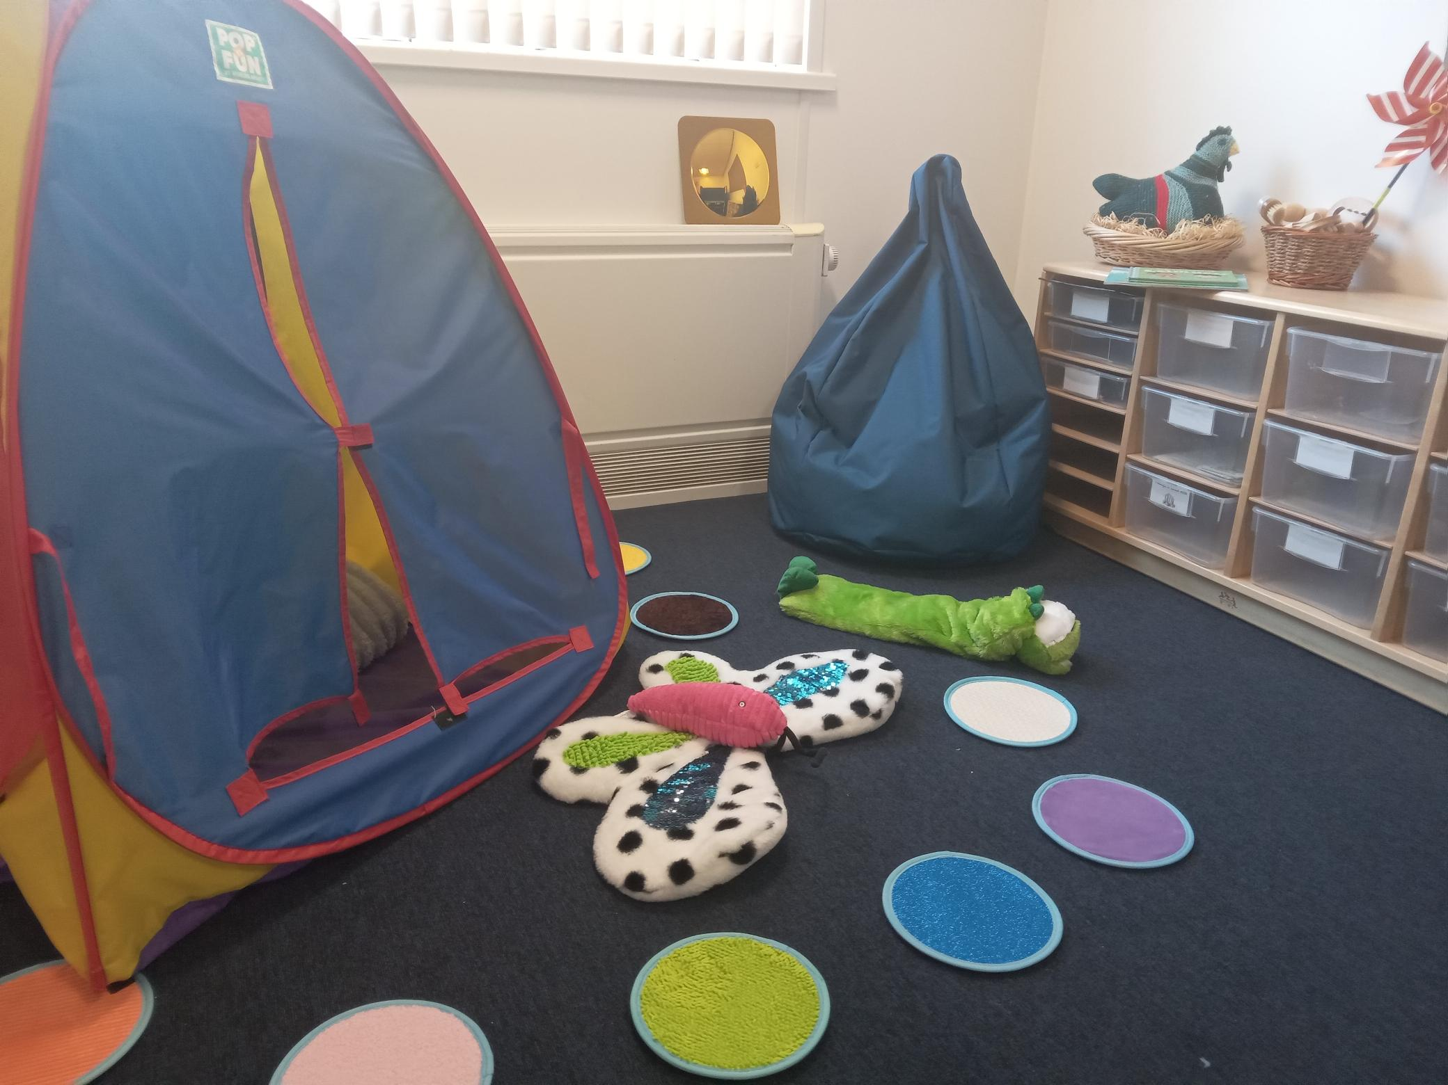
The Roost
This room is named The Roost, as this is a place where child your can go to if they need to become grounded and reconnect. It is to enable your child space to cope with any challenges. It is a safe, secure space where children can have some completely alone time, or release any energy depending on what they need to regulate their emotions and feelings.

Slide 8
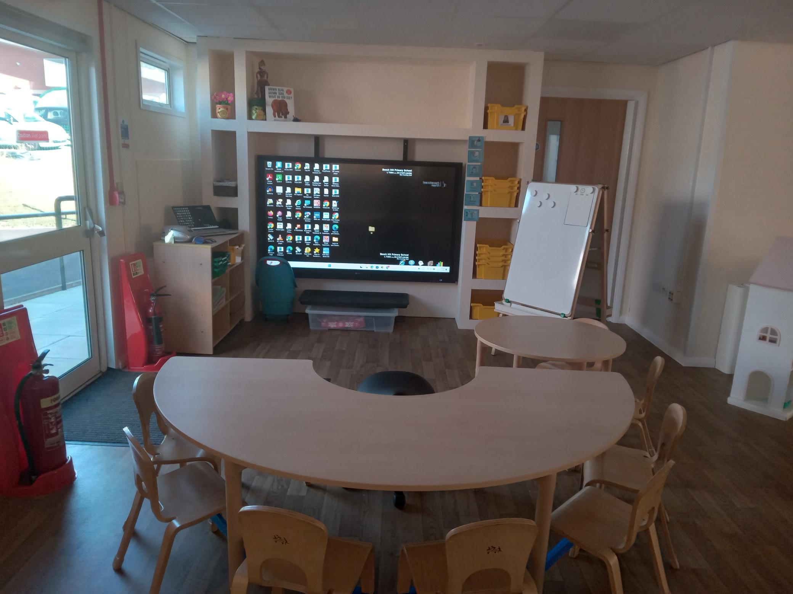
Curriculum and Learning
Each child’s learning journey will look different but there is a clear focus to ensure that all pupils are working towards their targets identified in their EHC plan.
Dependent on the stage of development, most pupils will initially focus on the pre-formal stage. As children progress, they will move beyond the pre-formal curriculum and into the pre-formal plus then semi formal curriculum. The pre-formal and semi formal curricula give the opportunity to focus on readiness for learning allowing for a skill-based, engagement approach to learning.
For all children specific interventions will be timetabled into their school day to help support and develop their learning and personal skills.
Interventions and focused teaching programmes will be delivered either 1:1 or in a small group and include:-
• Colourful Semantics
• Curiosity Programme
• Attention Autism
• Intensive interactions
• Messy Maths
• Communication Group
• Sensory Circuits
• Music Interactions
• Speech and Language Programmes

Slide 9
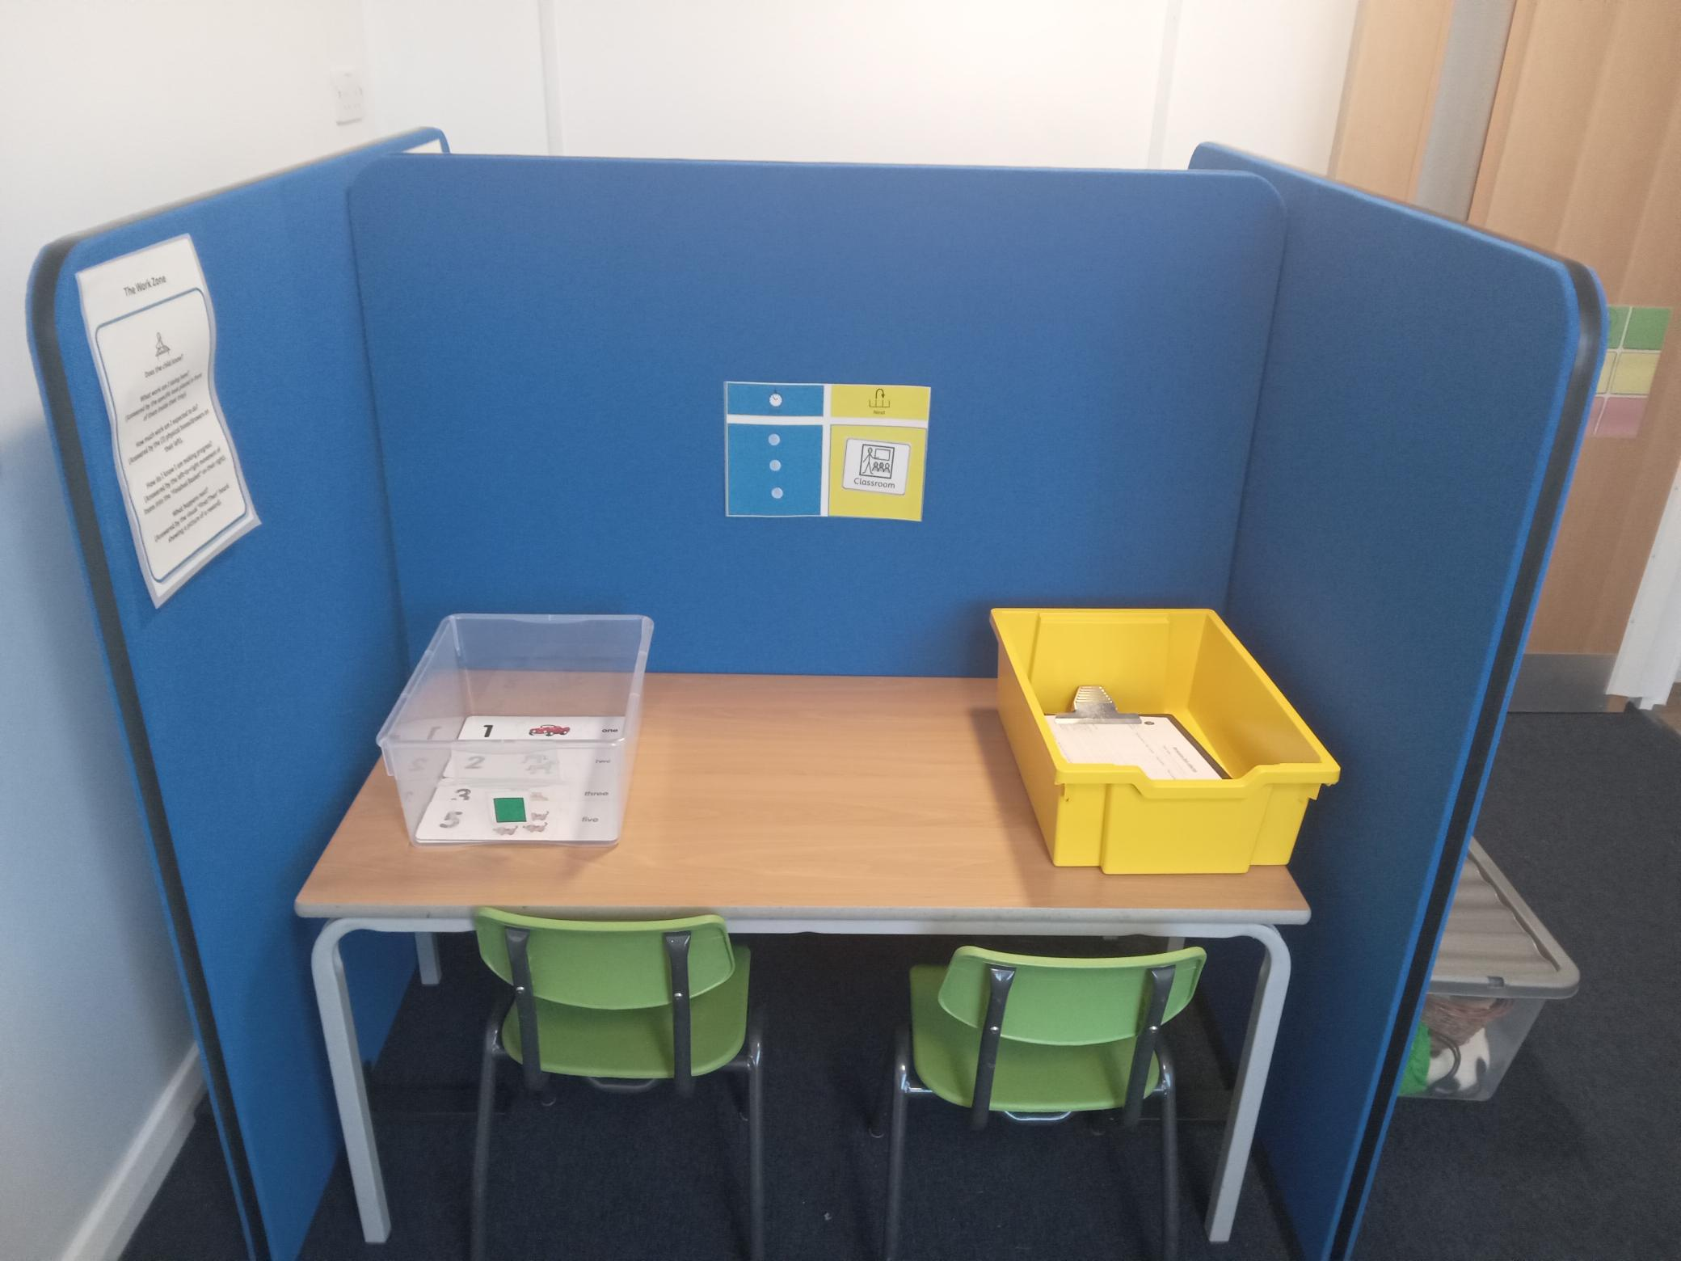
Assessment
Assessment will be focused on the individual child. They will be tracked and assessed through observation and assessment activities and recorded using the BSquared assessment tool which breaks learning down into smaller steps.

Slide 10
What to bring to school
Your child will be learning in both our indoor and outdoor environment so, with that in mind, they will need:
A warm waterproof coat with your child’s name in (nothing expensive as it could get sandy/muddy/wet).
A school book bag
What not to bring
Toys from home – we do not want to be responsible for any losses or breakages.
Snacks (we provide snack for the children).
Bags other than school book bag. If your child needs hygiene products, please label and use a small bag to transport. Any products can be then kept in class.

Slide 11

Helping your child to learn
We will share our learning with you through our online Class Dojo account. Details of how to sign up to the class account will be sent by email in the next few weeks.
You can then use Class Dojo to see what your child has been learning in school each week and to add your own photos and observations of things that you have been doing together at home. This could be the completion of an activity suggested by the class teacher, an activity such as dancing or swimming etc. or even the celebration of a family event or outing.
By using Class Dojo in this way the class teachers and you as parents can get an all-round view of what the children are learning as well as what their next steps might be.

Slide 12
Developing Independence
Toileting
When toileting accidents happen these are dealt with sensitively and discreetly, with the minimum of fuss. If your child has regular accidents, you are welcome to put spare underwear in their book bags.
Practice the ‘Independent Toilet Routine’ over summer. Encourage your child to pull their own clothes up and down, wipe independently, flush and wash their hands with soap.
School-Ready Clothing: Elasticated waistbands are much easier than fiddly buttons and belts.

Slide 13
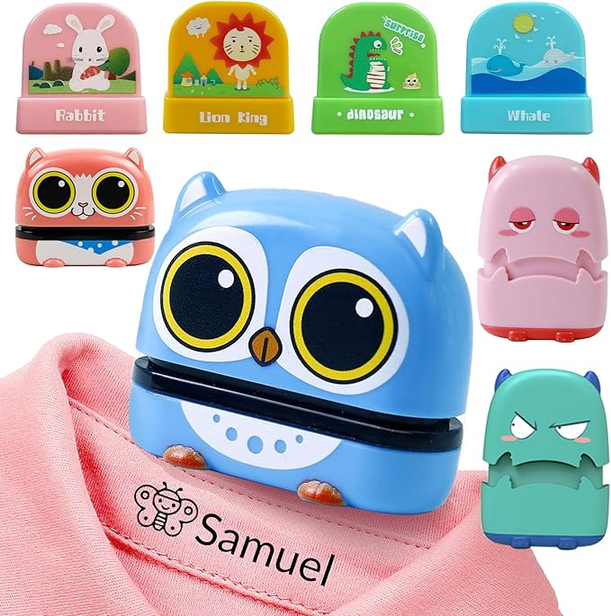
Developing Independence
Own Belongings
We will be encouraging the children to be independent and take responsibility for hanging up their coat and bags on their pegs and for looking after them. However, inevitably things can go astray, so it is VERY important that all your child’s things (including coats, shoes, bags and lunchboxes) are clearly named. You can buy labels or write their name on labels in their clothing.
Put your child’s name in all of the clothes that they wear to school including coats.
These ink stamps are amazing for labelling clothes and belongings and cost about £5.

Slide 14
Food and Drink
Drinks
Children will have access to milk and water throughout the day. They are encouraged to pour their own drinks whilst sat at the table.
Snack
Children will have a snack of fruit or vegetable daily. At any time when children are eating, a paediatric first aid (PFA) trained member of staff will be present.
Encourage your child to practice serving themselves and clearing away once they have finished at home however that may look like for them.
Encourage your child to try a range of new and unfamiliar foods.

Slide 15
Food and Drink
Lunch
Hot school lunch
Our school cook, prepares healthy hot meals for us every day in our school kitchen. These meals are currently free for children in Reception, Year 1 and Year 2.
Packed Lunch
You can choose to give your child a packed lunch but these must not contain any nut based products. We encourage healthy food choices and ask that no sweets or chocolate should be put in packed lunch boxes. The packed lunch should include a drink that is in a plastic bottle or carton (no glass).
School lunches are free for children in Reception.
No sweets, chocolate or nut based products allowed.
Name all packed lunch bags on the outside.

Slide 16


School Uniform
All children should be dressed in school uniform. We believe that by wearing the school uniform children are encouraged to take pride in belonging to the school.
Item of clothing | School expectations Reception
Shirt | White polo shirt or white shirt
Bottoms | Dark grey trousers / skirt / pinafore dress Summer options: grey shorts / light blue checked summer dress
Jumper/ Cardigan | Beech Hill sweatshirt or cardigan with school badge on
Shoes | Sensible black flat school shoes with no other colour/logo
Socks | White/grey/grey tights
PE | White plain t shirt, navy shorts, black plimsolls or optional badged kit.
Basic uniform can be purchased from most supermarkets.
Badges items can be purchased from Topmarks or Slaters.

Slide 17
Staying in Touch
In Person
Staff are always available on the door before and after school for quick messages or questions. If you need longer to discuss an issue please ask the staff to make an appointment at a convenient time.
ClassDojo
Please turn on notifications on Class Dojo so that you get our regular updates and any reminders about special events that might be happening. Please note that messages are not monitored on Class Dojo so please do not use the messaging feature to contact staff.
Urgent Matters: For same day changes to pick up or emergencies, please call the school office directly on [01942 243582].
Never hesitate to tell us about the ‘little things’. If your child had a poor night’s sleep or is feeling a bit anxious about something, let us know at the door. Knowing these small details helps us understand your child's mood and lets us give them the extra comfort needed.

Slide 18
Staying in Touch
Arbor App
The Arbor App is like a mobile dashboard for your child's school life. Once you download the app, you will be able to:
Stay Informed: Receive all important school messages, letters, and reminders directly to your phone.
Manage Logistics: Easily sign up and pay for trips and after school clubs.
School Website Here is the school website address: www.beechhillwigan.co.uk. You can find lots of useful information on here.
School Newsletter
There is a weekly newsletter that will be sent to you via School Arbor App on a Friday. Please make sure that you read it, as it tells you about school developments and events. Newsletters are also uploaded to our website.
Keep an eye out for a welcome email from Arbor over the coming weeks, which will contain your login details and instructions to get you started.

Slide 19
School Attendance
Good attendance helps your child learn, make friends, and succeed.
Illness
In the case of illness please telephone or email the school office to let us know. We operate a ‘first day phone call’ system. If we have not heard from a parent about their child’s absence by 9.00am we will contact them by telephone to find out the reason. Try to book any medical appointments outside school hours. If this is not possible, please let us know in advance where possible.
If your child has sickness or diarrhea, this must be followed by a 48 hour absence.
Contact school before 9am if your child is absent.
Your child MUST stay at home for 48 hours after the last bout of sickness or diarrhea.

Slide 20
School Attendance
Administering medicine
Medicine (both prescription and non-prescription) will only be administered if they have been prescribed for the child by a medical practitioner and where written permission for that particular medicine has been obtained from the child’s parent and/or carer.
Holiday
The government expects schools to promote good attendance and act early to address patterns of absence.
Term time leave will only be authorised in exceptional circumstances. If you believe this to be the case, please speak to a member of staff for further guidance. Otherwise, please do not request permission for holidays during term time as this will not be granted.
Regular attendance keeps your child safe, supported, and learning.
Holidays in term time will not be authorised unless there are exceptional circumstances.

Slide 21
Working With Other Professionals
The provision will work in collaboration with other professionals as stipulated in the child’s EHCP. Outside agencies may include:
• SEND team
• Educational Psychologist
• CAMHS
• Speech and Language Team
• Occupational Therapy
• School nurse
• Social services
• Other professionals should the need arise

