Slide 1
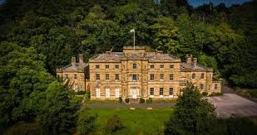
Year 6 Residential to
Willersley Castle
28th September – 2nd October 2026

Slide 2
Monday 28th September 2026
Children to arrive at school at the normal time – 8:45 am.
Luggage to be brought to Meeting Room in the Top Building – gates at the side will be open for access.
Medication must be labelled with child’s name and dosage and handed to a First Aider.
Money – maximum of £10.00 in change please! Please put in an envelope with your child’s name on it.
Lunch – children will have lunch at 11:15am. For children who bring a packed lunch please put it in a carrier bag for this one day.
The coach has been booked to depart at 12:00pm.

Slide 3
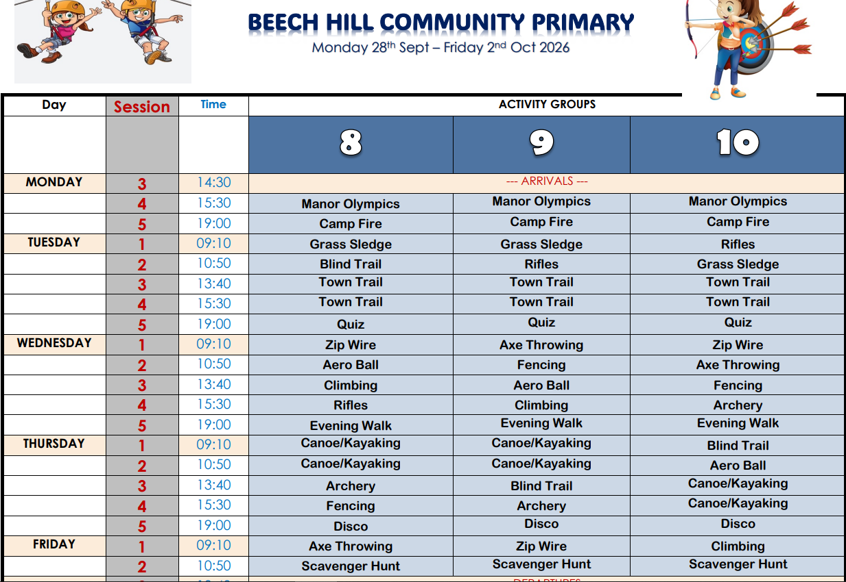

Slide 4
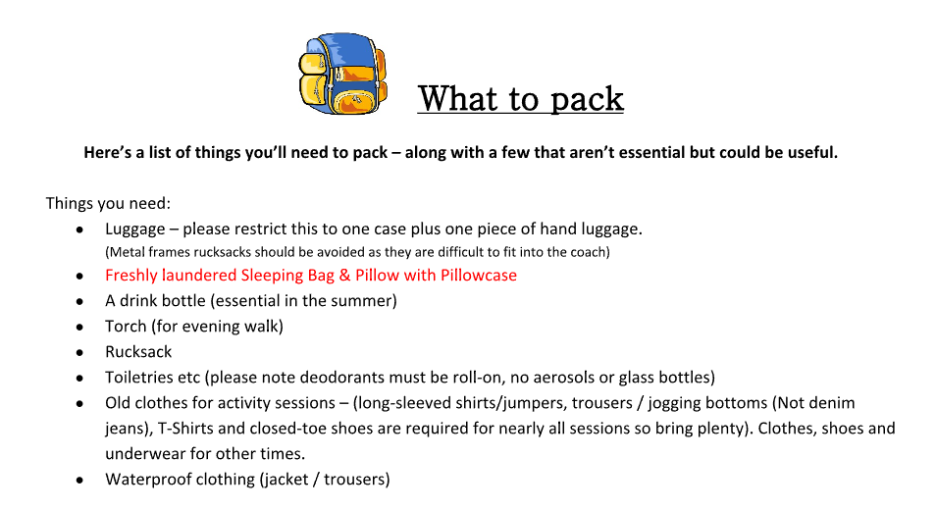

Slide 5
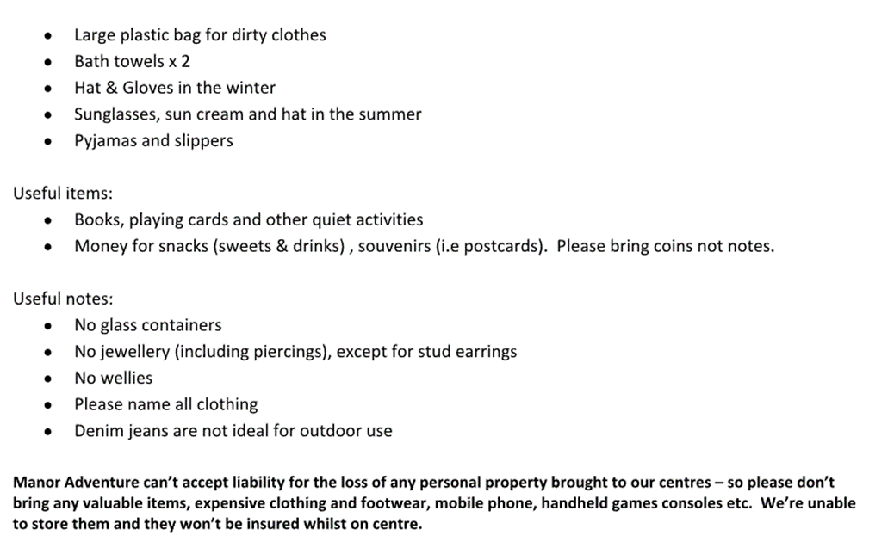

Slide 6

No mobile phones or electronic gadgets!

Slide 7

Friday 2nd October 2026
Depart Willersley Castle about 1:30pm
Arrive back at school between 3:30 – 4:00pm.
Please ensure an up to date contact number is provided to the office so that you can be updated if we happen to be delayed on our return journey.

